Slide 1
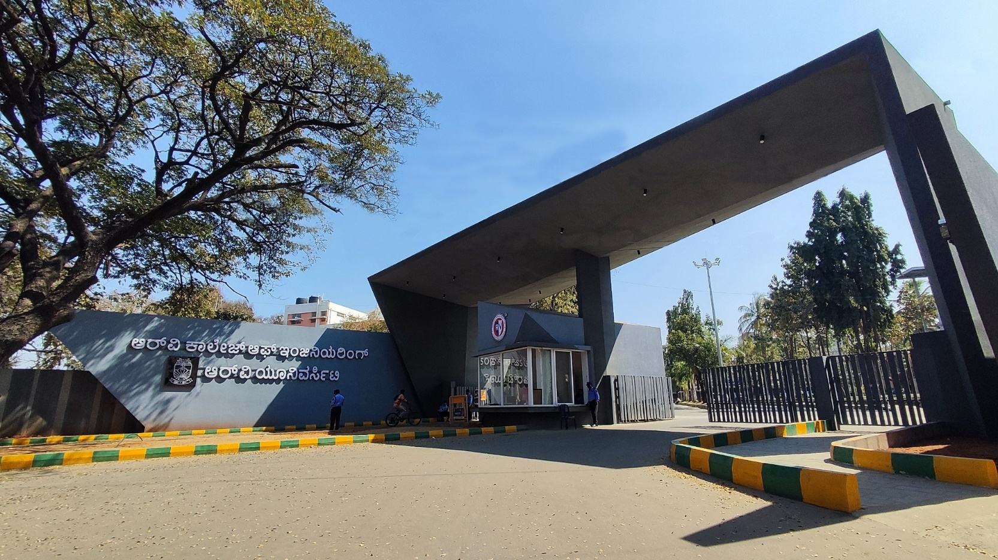
SMART SOLAR EV CHARGING STATIONS
URBAN DEVELOPMENT,MOBILITY AND SMART CITIES & GROUP NO-10

Slide 2
GROUP MEMBERS
S.NO | NAME | BRANCH | ADMISSION NO.
1. | Abhinand N Shamin | ECE | 1RV25EC005
2. | Alvin K Boby | ECE | 1RV25EC026
3. | Rithvik Chennupati | CSE | 1RV25CS147
4. | Syed Farhan Hashmi | CSE | 1RV25CS184
5. | Ashvath.M | CSE | 1RV25CS033
Mentor Name: Dr Madhu BR

Slide 3
EL Phase-3
Presentation Outline
Introduction
Project Overview
Comments during EL Phase-2 and action taken.
Tools and Techniques Used
Project Progress
Analysis of Partial Results
Deliverables and Outcomes
Future work (Remaining tasks)
Conclusion

Slide 4
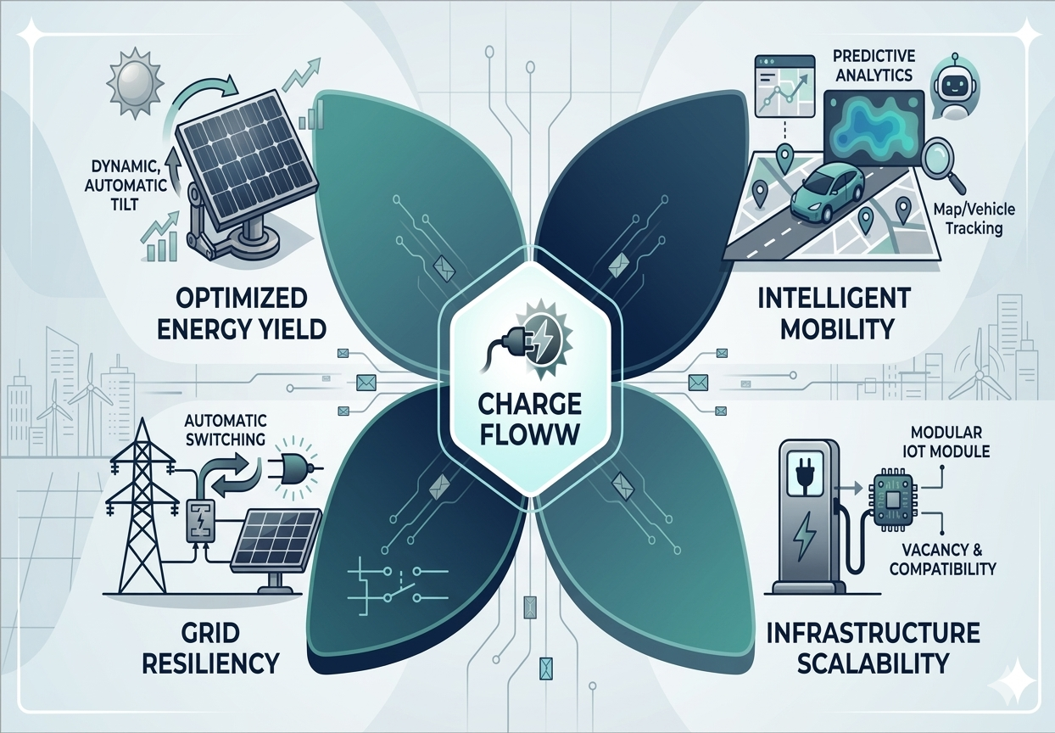
Introduction
Overview of the topic:
Charge Floww is an autonomous energy management ecosystem. It integrates dual-axis solar tilting, dynamic source switching, and a Universal IoT Retrofit Module to optimize renewable utility and legacy infrastructure.
Importance of the topic:
With 230M EVs projected by 2030, Charge Floww was established to eliminate 'range anxiety' by integrating IoT-based solar charging with real-time station telemetry, creating a foundational smart-grid ecosystem.
Infrastructure Scalability: Enabling Legacy Station Digitization through modular IoT attachments to solve the global compatibility crisis.

Slide 5
Project Overview
Problem statement:
EV users face rising range and charger anxiety due to unreliable stations and a 1-in-5 failure rate, while growing EV demand strains power grids. A smart, solar-powered, IoT-connected charging system is needed to provide reliable, real-time, and sustainable charging.
Objectives:
1. Create a user-friendly website platform that empowers EV users to apply real-time functions for locating, monitoring, and reserving charging stations.
2. Apply IoT technology to analyze charging unit data, enabling smart monitoring, predictive maintenance, and evaluation of efficient load management strategies.
3. Design and implement a solar-powered charging system capable of producing clean, renewable, and self-sustaining energy for electric vehicles.
4. Analyze the interoperability of the website, IoT system, and solar infrastructure to evaluate and enhance overall charging reliability and user confidence.
5. Apply an AI chatbot to interpret user needs and simplify interface navigation, thereby bridging the comprehension gap between the user and the platform.

Slide 6
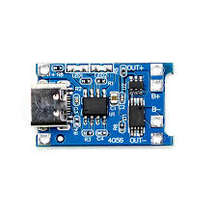
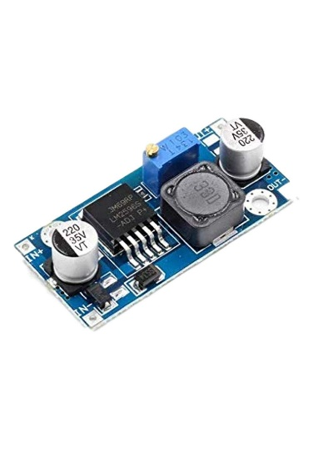
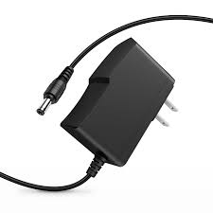
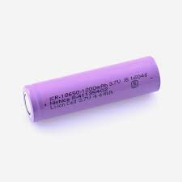

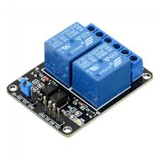
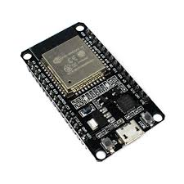
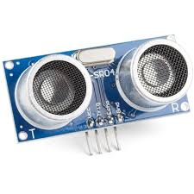
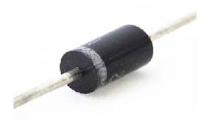
Tools and Techniques Used
Hardware tools used
TP4056
Buck Step Down Convertor
Lithium ion Batteries
DC 5V Charger
9V 3W Solar Panel
2 Channel Relay
Ultrasonic Sensor
ESP-32 Microcontroller
Schottky Diode
Jumper Wires
Servo Motor
6 LDR Modules

Slide 7
Tools and Techniques Used
Software tools used
1. Firebase – Backend-as-a-Service for real-time database, authentication, and cloud storage.
2. GitHub – Version control, collaboration, and repository management
3. Visual Studio Code (VS Code) – Main code editor with development extensions.
4. Arduino IDE – Used to program IoT hardware and sensors
5. OpenChargeMap – Provides global EV charging station data.
6. OpenStreetMap (OSM) – Open-source mapping platform used for map rendering
7. GraphHopper API – Routing and navigation engine for calculating EV routes.
8. Python – we used python for the AI predictive Analysis
9. Flask microframework – used to design dynamic backend for the website

Slide 8
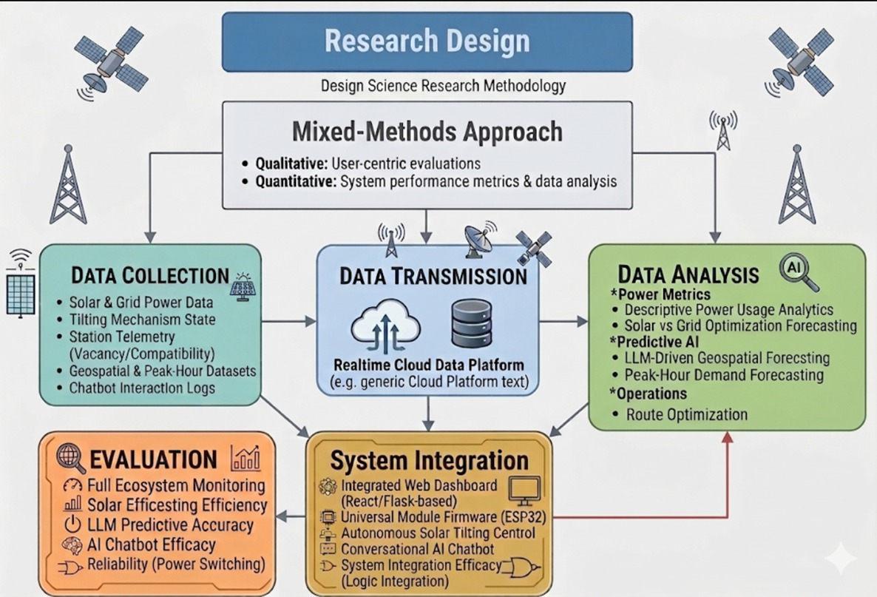
Project Progress
Flowchart representing overall progress and architecture

Slide 9
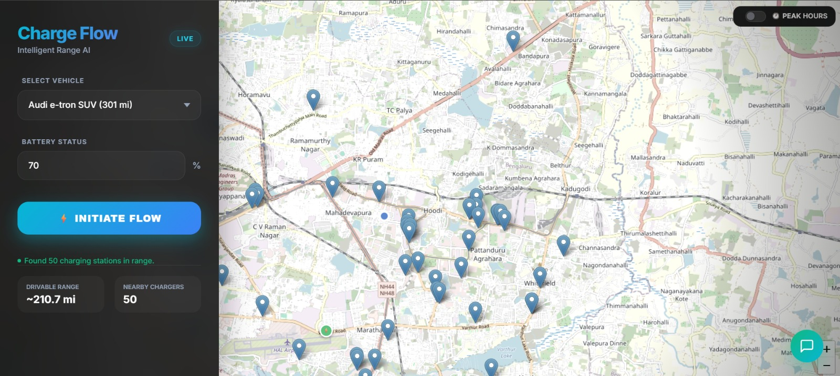
Analysis of Partial Results
Website Interface and features implemented

Slide 10
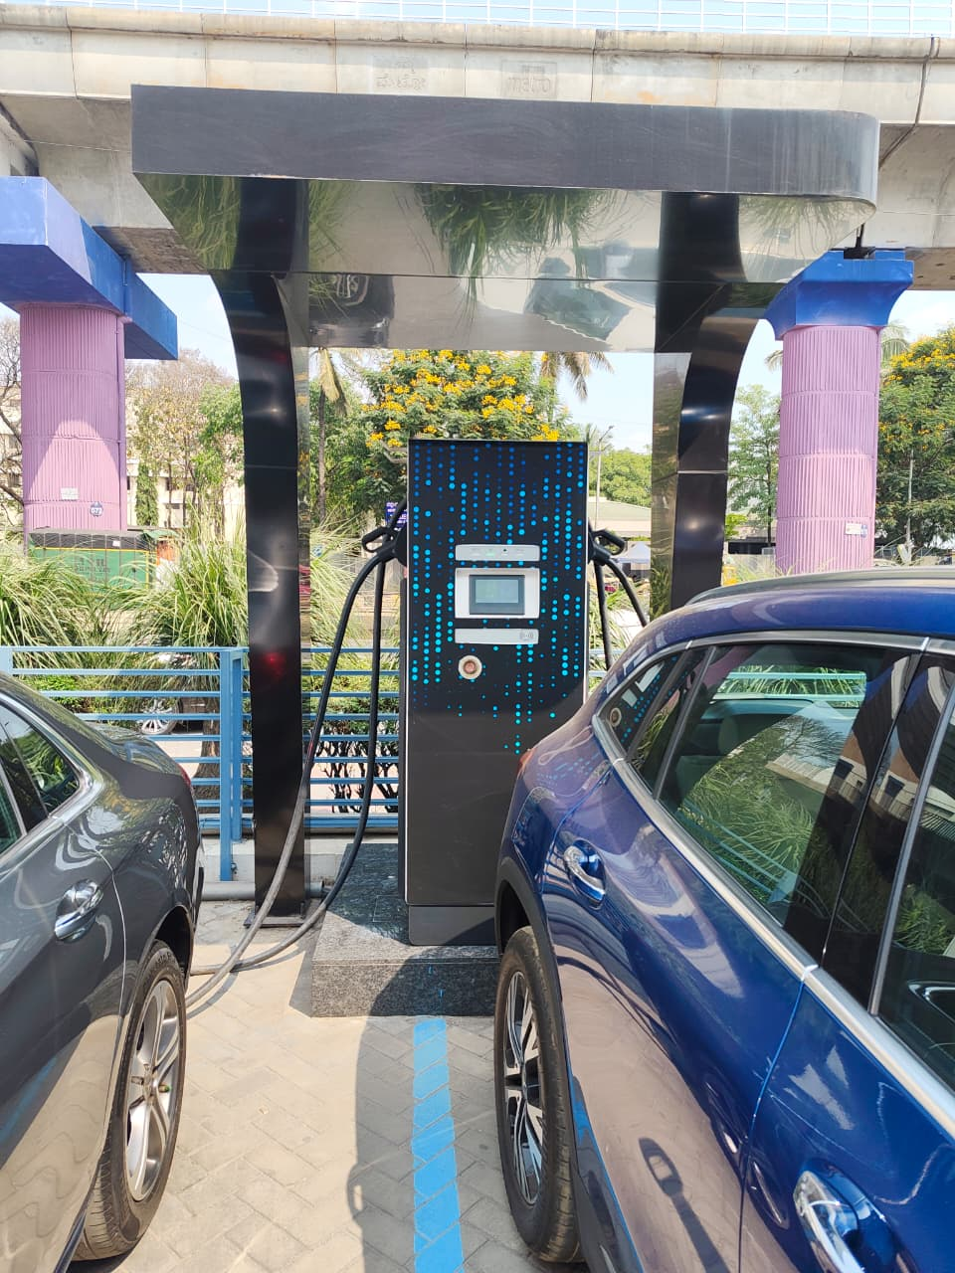
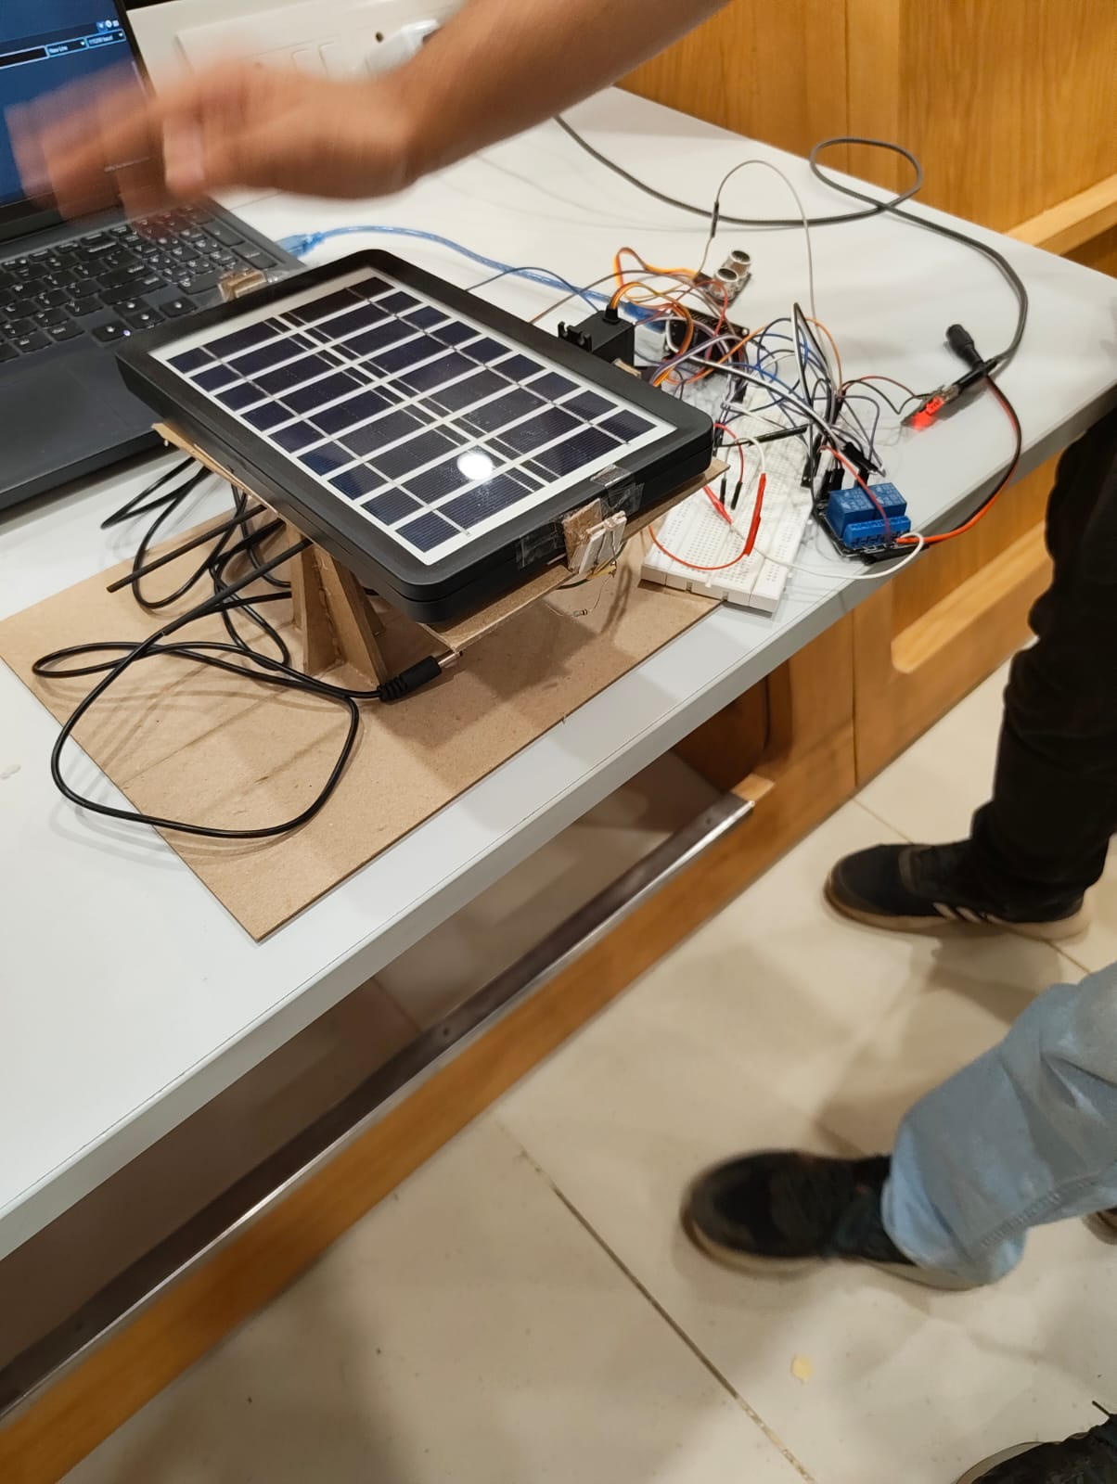
Analysis of Partial Results
Nearby Mercedes EV Charging Station Survey
Project Testing and Circuit Connections

Slide 11
Analysis of Partial Results
We successfully sent data like occupancy, location from ESP-32 to a Real time data base called FireBase.
Successfully created a Circuit which timely switch between Solar and battery grid to charge an EV car
Safely done the circuit to prevent any kind of shocks or short circuits
A Website using the API calls like OpenchargeMap, OpenStreetMap, GraphHopper to display the map and locate nearby charging stations and provide routes to them respectively
Used servo Moter and LDR Modules to tilt towards sunlight to maximise output and efficiency
Monitor hourly Traffic on stations and identify Peak hour areas
Added extra feature to locate 5 nearest restaurants

Slide 12
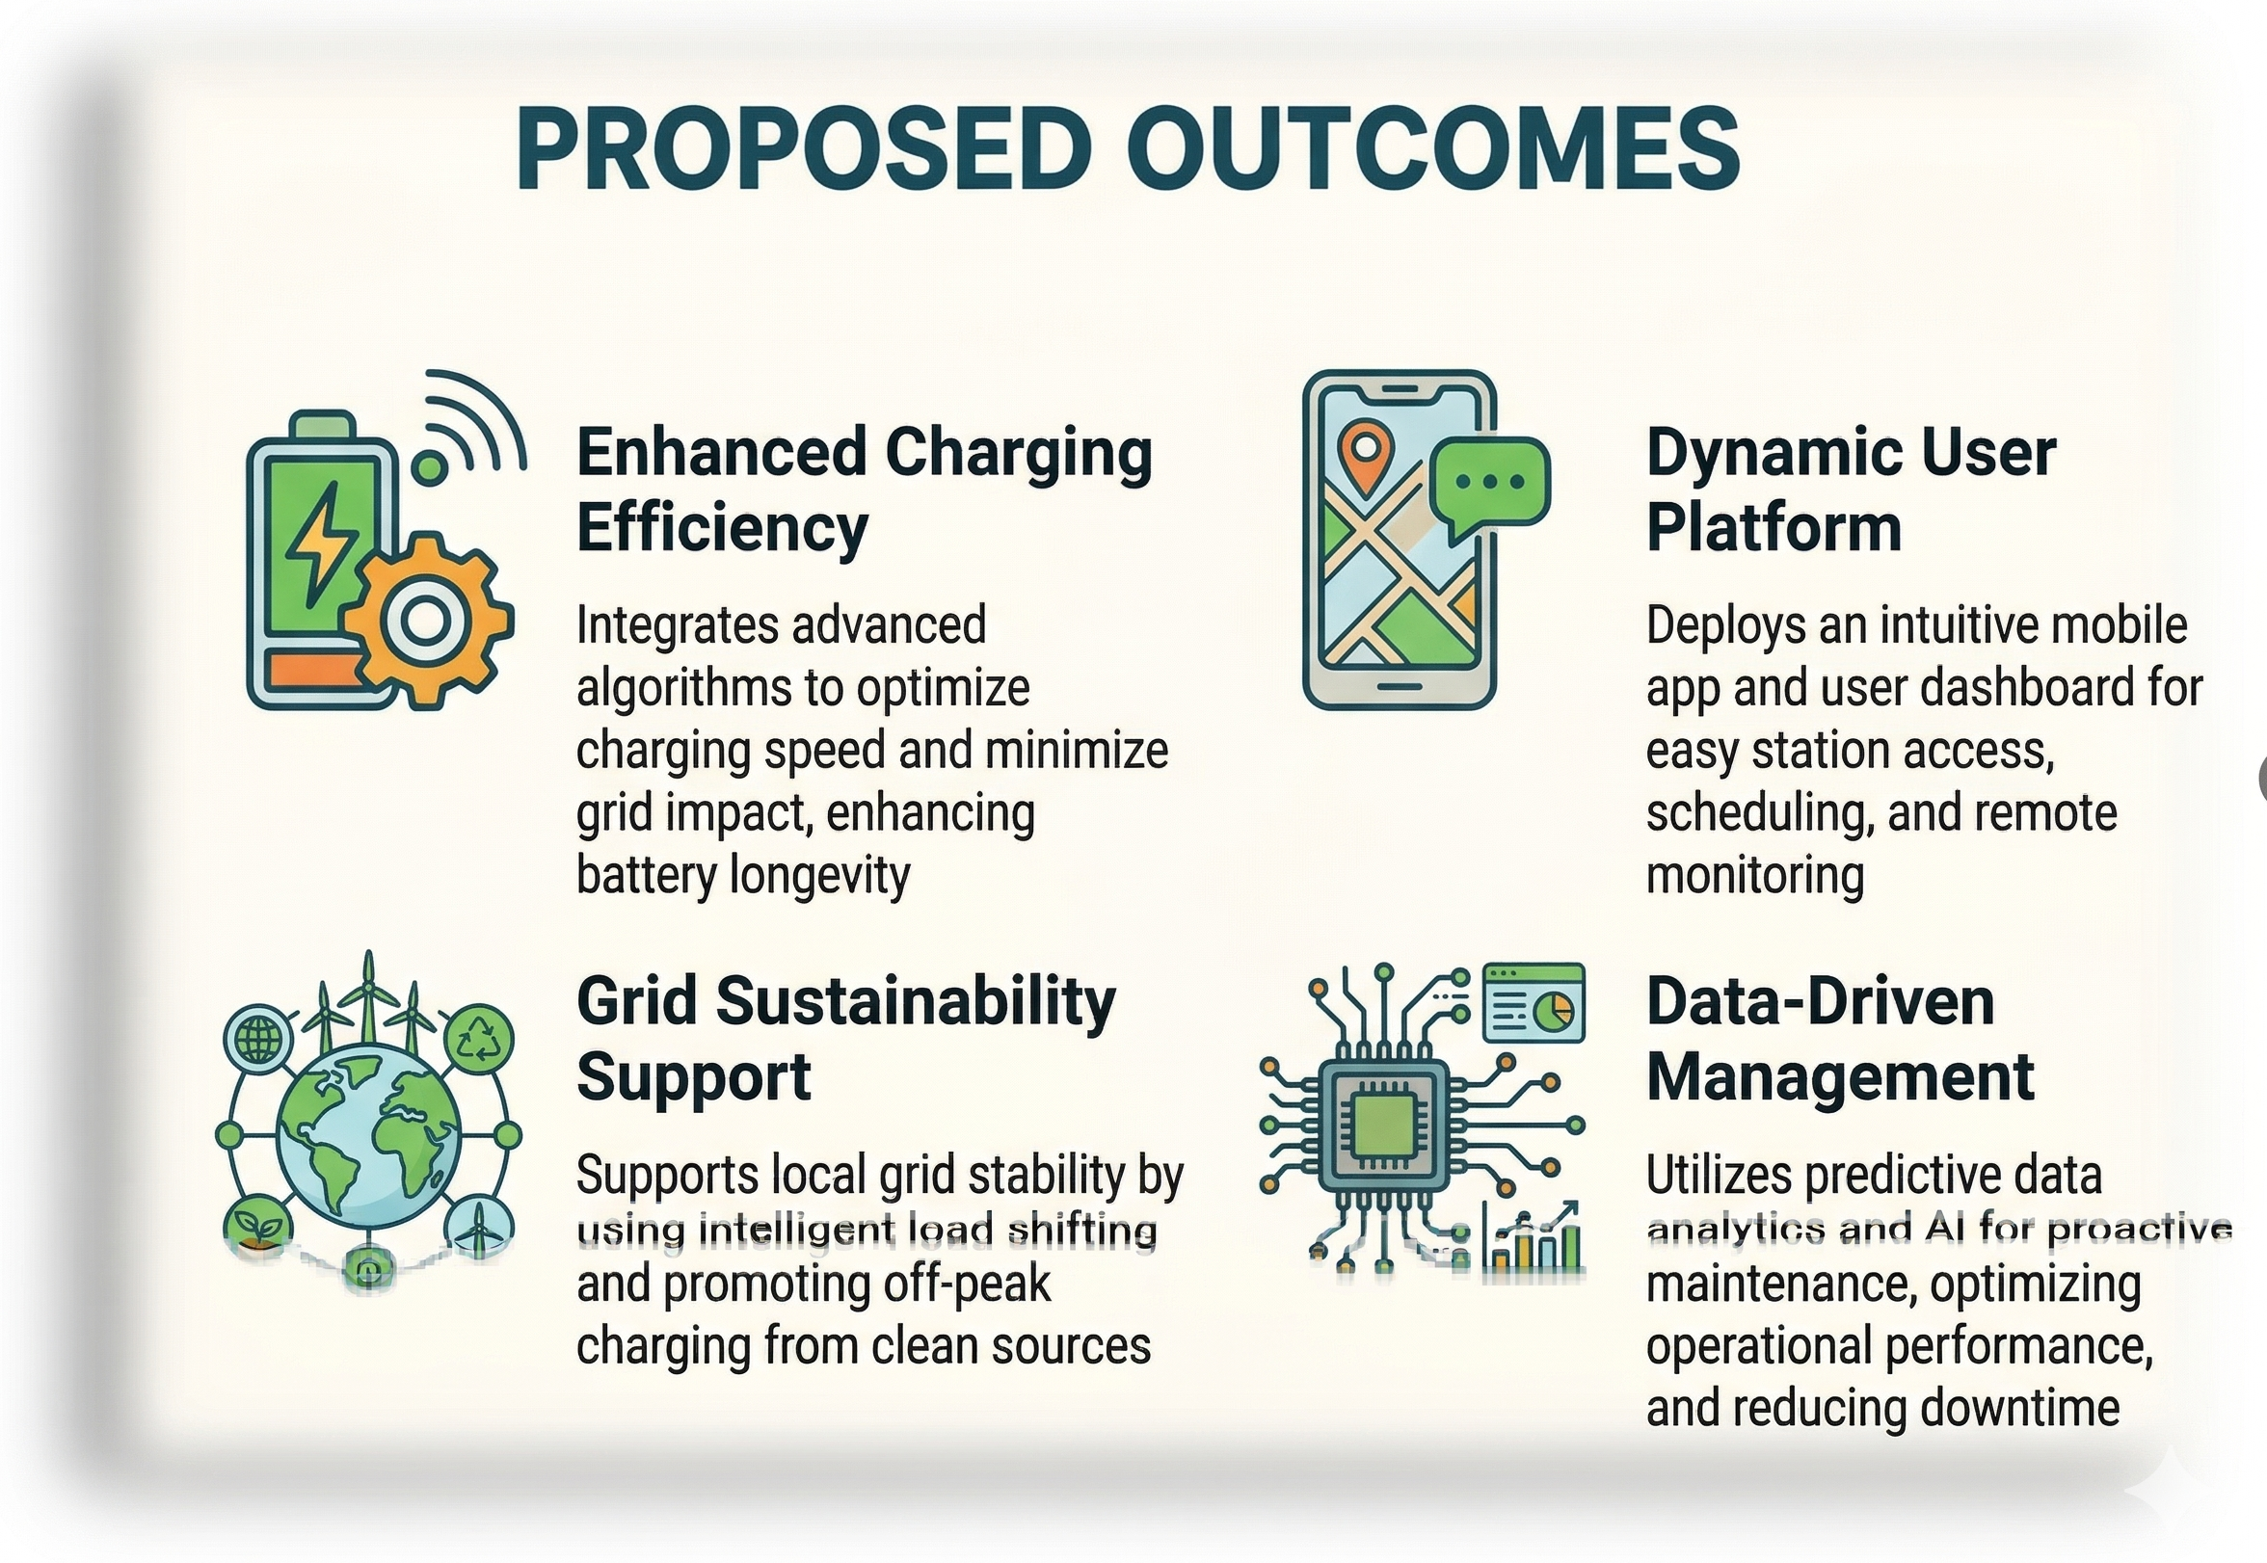
Deliverables and Outcomes
Working Solar Tracker Prototype: A small-scale model of a solar panel that automatically follows the sun. This proves the logic works before adding it to large, commercial stations to get more power.
AI Hotspot Predictor: A trained machine learning model that looks at past charging habits and local Bengaluru traffic to predict exactly when and where chargers will be busiest.
Universal Smart Charger Add-on: A custom-built device that can be attached to any standard, older EV charger to instantly track if it is empty and connect it to our live map.
Smart Search Interface: A system that understands normal human language, allowing drivers to find charging stations using simple, conversational commands instead of clicking through menus.
Smooth Hybrid Power Switch: An upgraded electrical setup that safely mixes solar power with the main grid. It switches between the two instantly so the car's charging session never drops

Slide 13
Future Work (Remaining Tasks)
Integrate AI Chatbot for user support, station suggestions, and troubleshooting.
Refine UI/UX to create a smoother, more intuitive user experience across web and mobile.
Expand IoT capabilities by adding more sensors (current, temperature, fault detection) and improving real-time data accuracy.
Optimize routing algorithms to include traffic, charger type, and energy consumption predictions.
Add user accounts & personalization for saved locations, charging history, and preferences.
Scale hardware prototype into a full solar charging module with enclosure and durability improvements.

Slide 14
Conclusion
Significant progress was achieved in Phase-II, including a functional web platform, real-time API integrations, and a working IoT smart charging prototype using ESP32, solar power, and sensors — all aligning strongly with the project’s objective of creating an intelligent EV charging ecosystem.
This phase establishes the foundation for Phase-III by enabling accurate station detection, routing, and live hardware communication, opening the path for advanced features like an AI-powered chatbot, refined UI/UX, and expanded IoT data insights.
The progress made was supported by effective collaboration, the use of industry-standard tools, and contributions from team members, mentors, and open-source communities (Firebase, OCM, OSM, GraphHopper).
Key takeaways from Phase-II include a deeper understanding of IoT–cloud integration, scalable API workflows, and user-centered system design — all of which will guide the continued enhancement of the platform in Phase-III.

Slide 15


